Slide 1


“Movie Booking Application”
Submitted by: Krishnapriya S
Submission type : Individual
Name: Movie Booking Application
Batch : B13
Program : Axis Fintech WOB
Date: 11/07/2023

Slide 2

Table of contents
Introduction
Project Overview
Architecture Design
User Interface Design
Back-end Development
Front-end Development
Testing
Deployment
Conclusion
Future Work
References
Appendices

Slide 3
Introduction
Application makes it easier for moviegoers to book tickets for their favourite movies.
Key features of the application :
Movie Search
Theatre Search
Booking History
Cancel Ticket
Movie Rating and Reviews
System optimizes the movie ticket booking process, minimize waiting times, and enhance the overall moviegoing experience.

Slide 4
Project Overview
Movie Search : Search for movies by title, genre, or release date.
Theatre Search: Search for theatres by location, theatre names.
Booking History: Maintain a record of user booking history for reference.
Ticket Cancellation: Cancel the ticket bookings, subject to the ticket cancellation policy of the theatre.
Movie Ratings and Reviews: Rate and review movies watched.

Slide 5
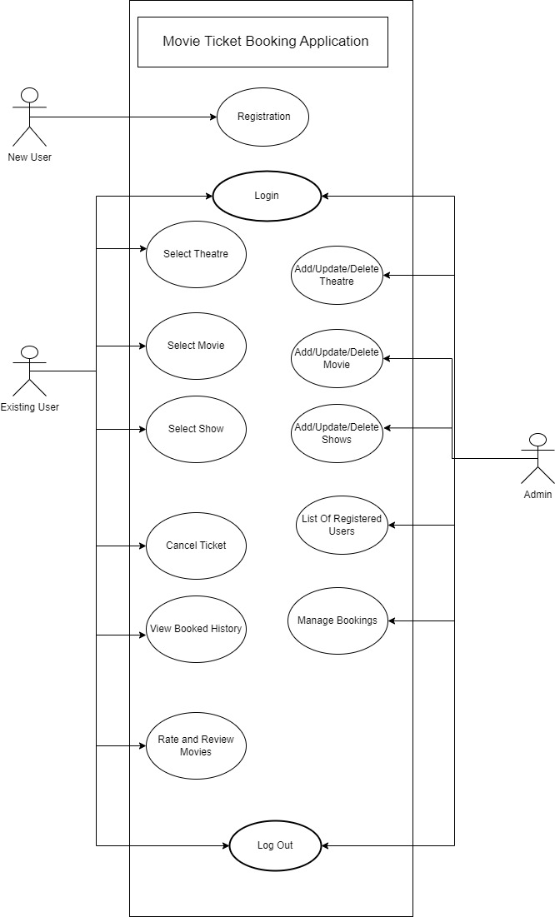
Use Case Diagram

Slide 6
Architecture Design
Table Name: Movies
Columns: movie_id, movie_title, genre, director, duration,release_date
Table Name: Theatres
Columns: theatre_id, theatre_name, location
Table Name: Bookings
Columns: booking_id, customer_id, show_id, booking_date, total_amount
Table Name : Users
Columns : customer_id , name, password, email, identity
Table Name : Ratings
Columns : rating_id, rating , review, user_id, movie_id
Table Name : Show_Time
Columns : id, show_date, start_time, theatre_id, movie_id

Slide 7
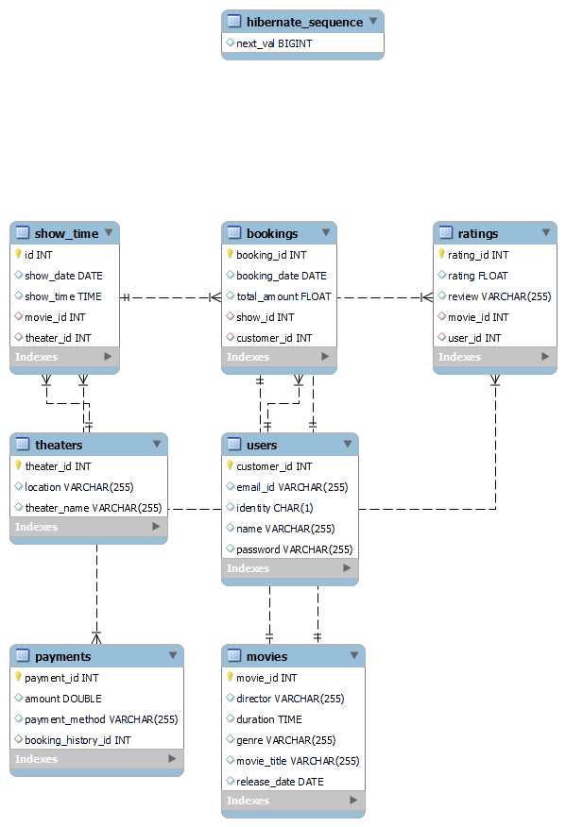
Back-end Design

Slide 8
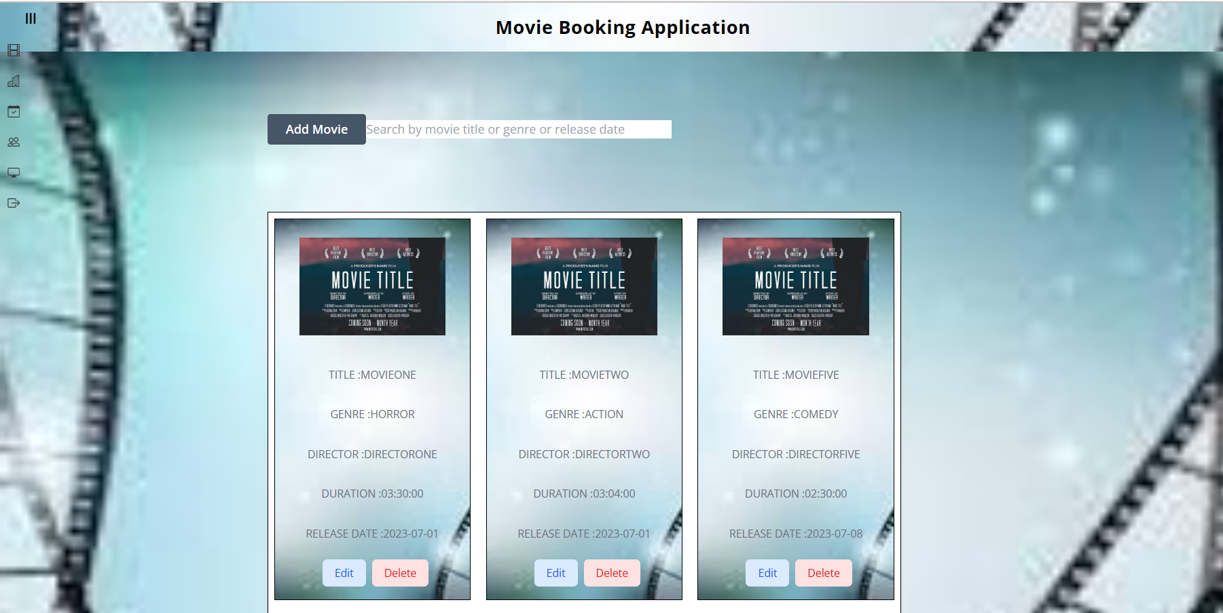
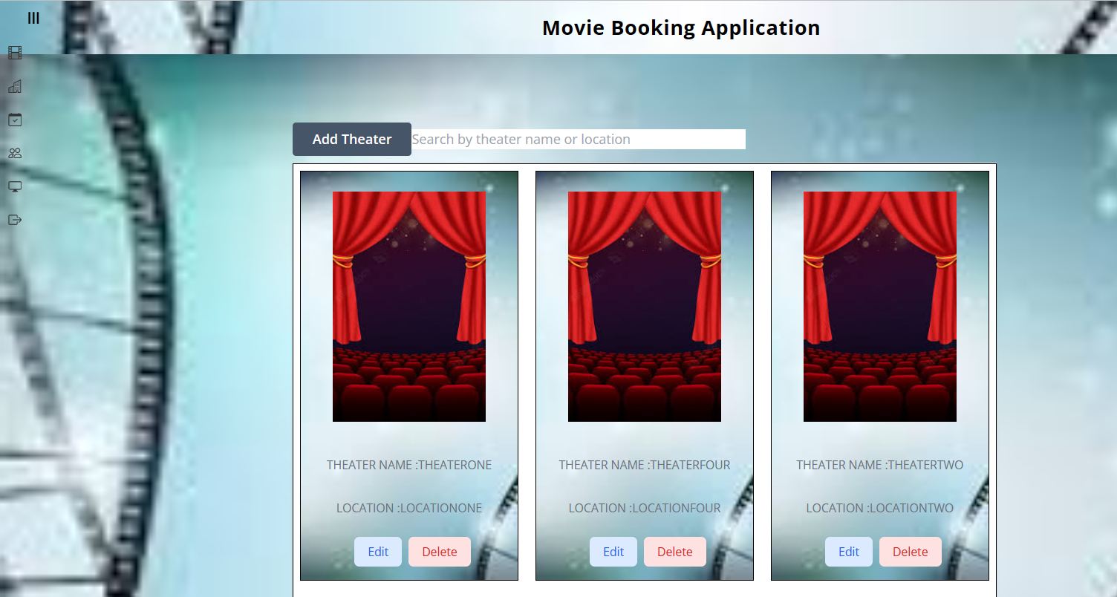
Front-end Design

Slide 9
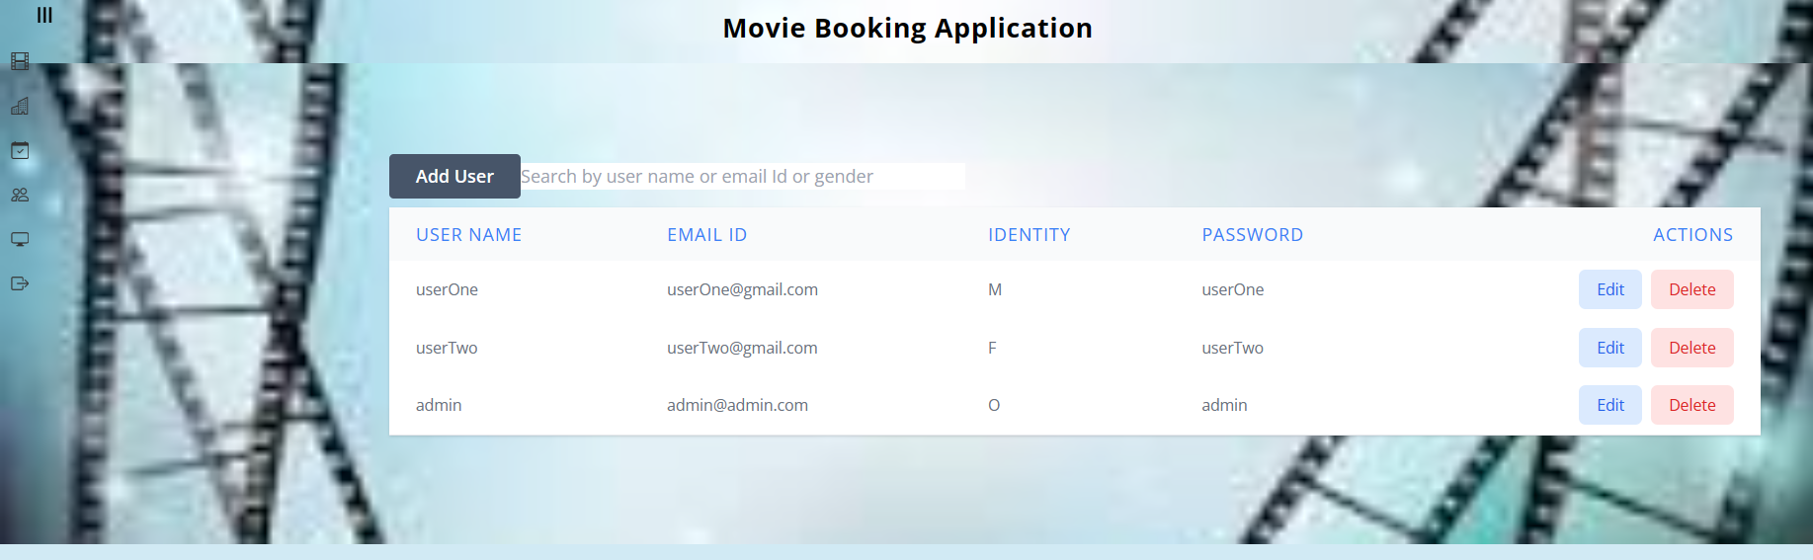
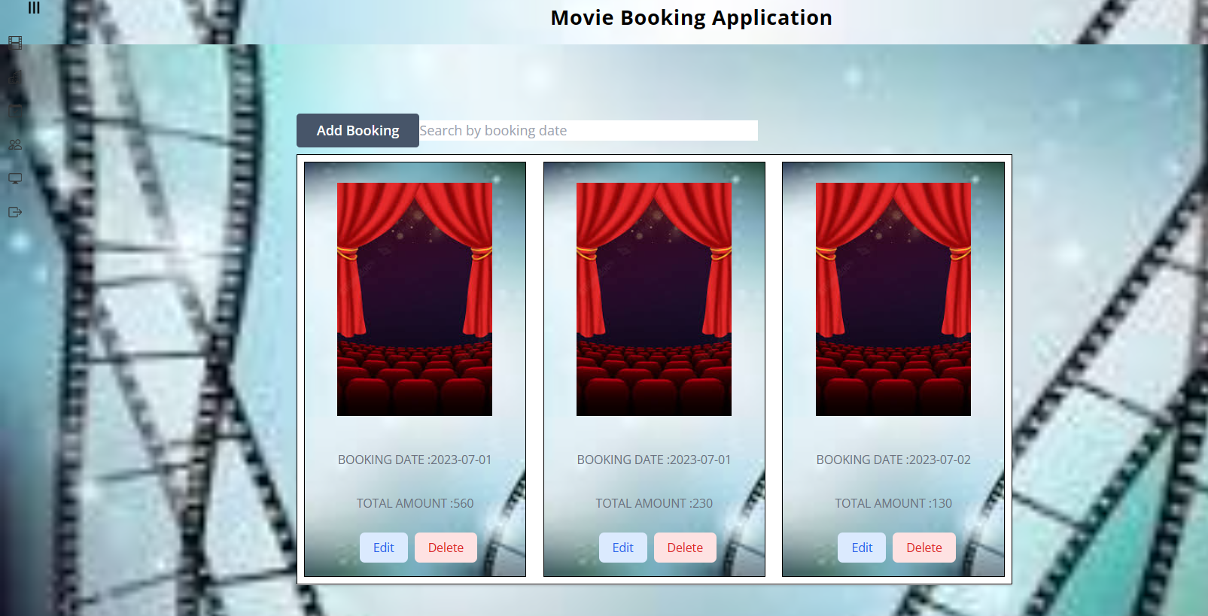
Front-end Design

Slide 10
Deployment
The project was deployed to Github using the following commands:
git init
git status
git add .
git commit –m “first commit”
git push –u origin master
The link to the Github repository :
https://github.com/Krishnapriyas/mid_term_project

Slide 11
Conclusion
Designed and developed a movie booking application that allows various functionalities like:
Movie Search
Theatre Search
Booking History
Cancel Ticket
Movie Rating and Reviews
Users can now book tickets to movies online without the hassle of standing in long queues.

Slide 12
Future Work
Include :
Seat Selection Component
Payment Component
User Interface

